Slide 1
Opioid Overdose Recognition and Naloxone Administration Training for Community Leaders
Michael Dulitz, MPH, NRP
Opiate Response Project Coordinator

Slide 2
Objectives
By the end of this training, you will
Know how to recognize overdose
Recognize the progression of an overdose
Know how to administer Narcan Nasal Spray
Be familiar with the relevant North Dakota laws permitting individual use of naloxone

Slide 4
When do people overdose?
Variability in quality
Adulteration
Mixing drugs
Benzodiazepines
Method of administration
Periods of Abstinence
Post-treatment
Post-hospitalization
Incarceration
Relapse
Using alone

Slide 5
Fentanyl
Equivalent Dosing
Morphine – 10 mg
Fentanyl – 0.1 mg (100 mcg)
Carfentanil – 0.001 mg (1 mcg)
Common adulterant in product sold as heroin

Slide 6
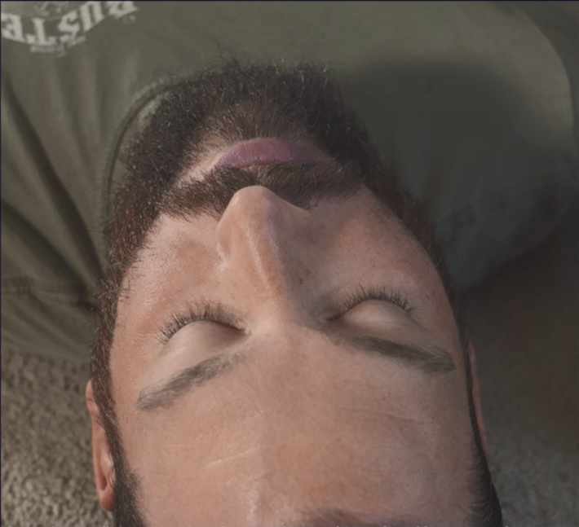
Signs of an overdose
Slow/shallow breathing
Less than 1 breath every 6 seconds
Gasping breaths
Blue skin tone
No response to pain
Sternal Rub
Small pupils – “Pinpoint Pupils”

Slide 7
Overdose Progression
Ingestion of excess heroin/opioid
Breathing effort slows
Slowing of breathing deprives brain, heart, and body of oxygen
Irreversible damage occurs to brain and other organs
Loss of consciousness
Death
Cardiac arrest occurs

Slide 8
Overdose Response
Recognize a potential opioid overdose
Notify medical responders of possible overdose
Administer naloxone (Narcan Nasal Spray)
Rescue breathing (1 breath every 6 seconds)
Place in Recovery Position (If breathing effort returns or you must leave the victim)
Provide care until EMS arrives
Inform EMS of interventions and complete report per departmental policy
Check for pulse, if no pulse, begin CPR
Repeat in 2-3 minutes if breathing effort does not return

Slide 9
Narcan Nasal Spray

Slide 10
Narcan Nasal Spray
18-24 month shelf life
Follow biohazard precautions for disposal
Storage and replacement per department policy

Slide 11
Naloxone

Slide 12
Narcan Nasal Spray
Safety
If naloxone is given to someone who hasn’t overdosed, there are no adverse effects
Naloxone does not work if given for a non-opioid overdose
i.e. Alcohol, Methamphetamine, Valium, Xanax, Ativan, etc.
Naloxone does not produce tolerance to opioids
Do not give if there is a known hypersensitivity to naloxone
Extremely rare

Slide 13
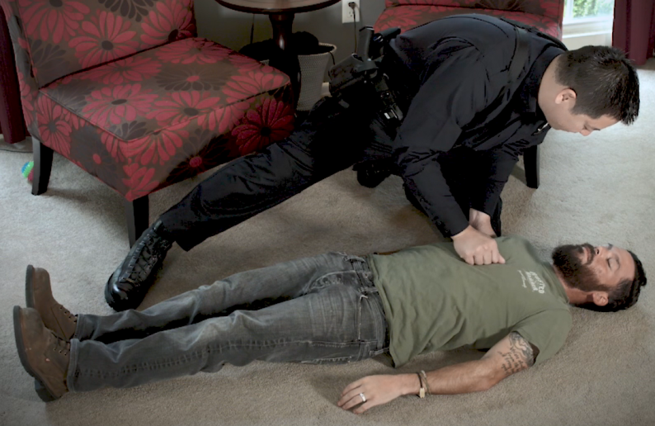
Narcan Administration

Slide 14
Narcan Administration

Slide 15
Narcan Administration

Slide 16
Post-Overdose Recovery

Slide 17
Post-Overdose Recovery
After recovery from overdose, the victim may experience:
Withdrawal-like symptoms
Confusion/Denial
Agitation/Anger
Prevent adverse reactions by keeping a calm, bystander free environment for recovery
Your safety is most important
These symptoms will not cause the victim harm

Slide 18
North Dakota Century Code 23-01-42
An individual acting in good faith may:
Receive and possess naloxone without a prescription
Administer naloxone to another individual for suspected opioid overdose
Receive immunity from liability for receiving, possessing, or administering naloxone as long as the individual’s actions do not constitute recklessness, gross negligence, or intentional misconduct.
Applies to all individuals without a medical duty to act.

Slide 19
North Dakota Century Code 32-03.1
Good Samaritan Act
No person who renders aid to other persons who have been injured or are ill may be named as a defendant or held liable in any personal injury civil action by any party in this state for acts or omissions unless alleged and proven to be intentional misconduct or gross negligence.
Applies to all individuals without a medical duty to act.

Slide 20
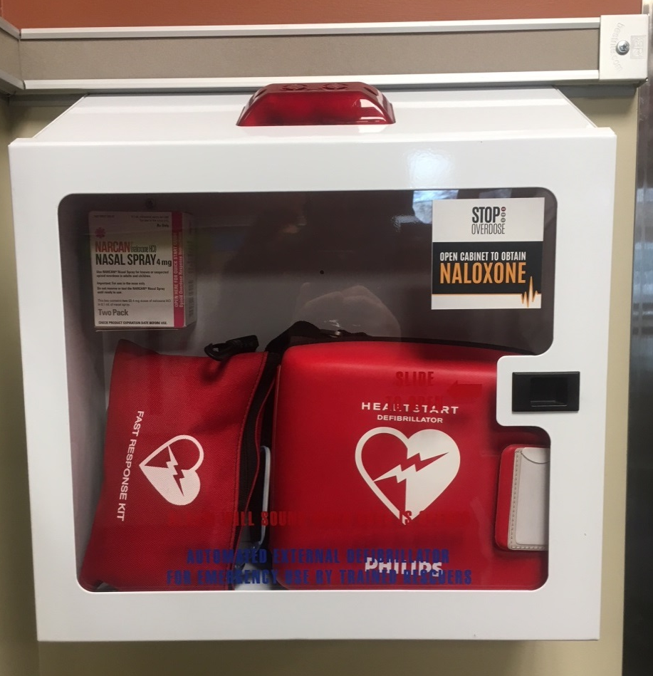
Public Access Narcan Locations

Slide 21
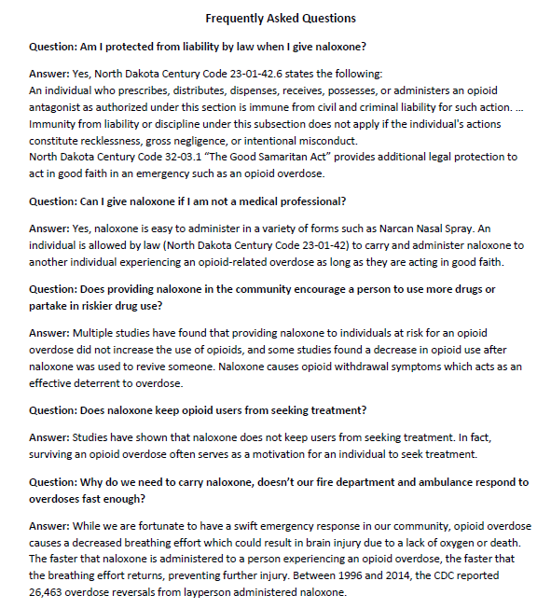
Questions?

